Slide 1
Green Button Initiative How to run and compile Virtual Machine
Jiwan Chong

Slide 2
Why use the VM?
The reason we use the VM is because the Common/DataCustodian/ThirdParty repositories gave errors upon attempting to compile and run each repository.
Most of the code was deprecated
Although it seems the GitHub has been updated

Slide 3
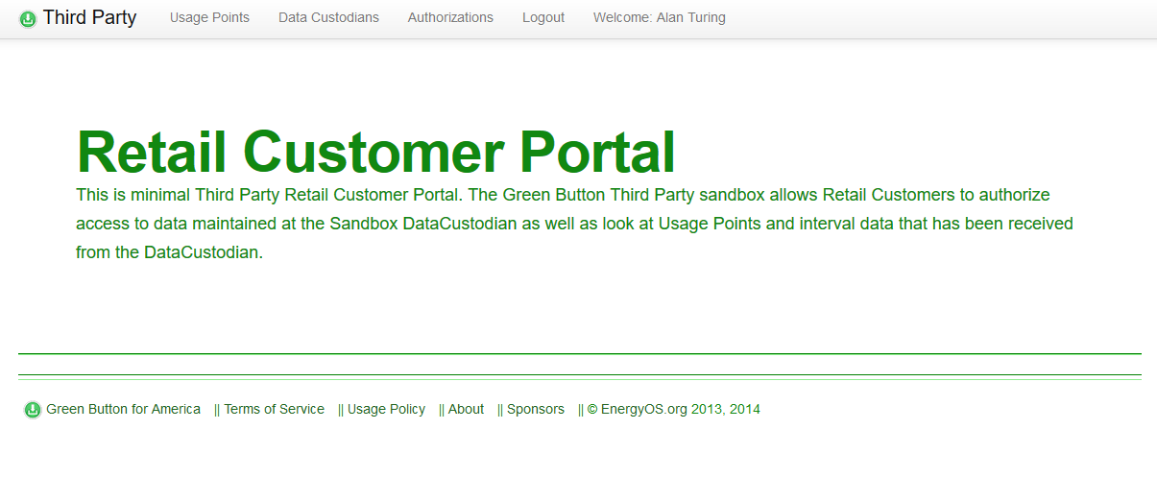
End Result (Demo)
Something similar – if not the same – as their sandbox
https://sandbox.greenbuttonalliance.org:8443/DataCustodian
https://sandbox.greenbuttonalliance.org:8443/ThirdParty

Slide 4
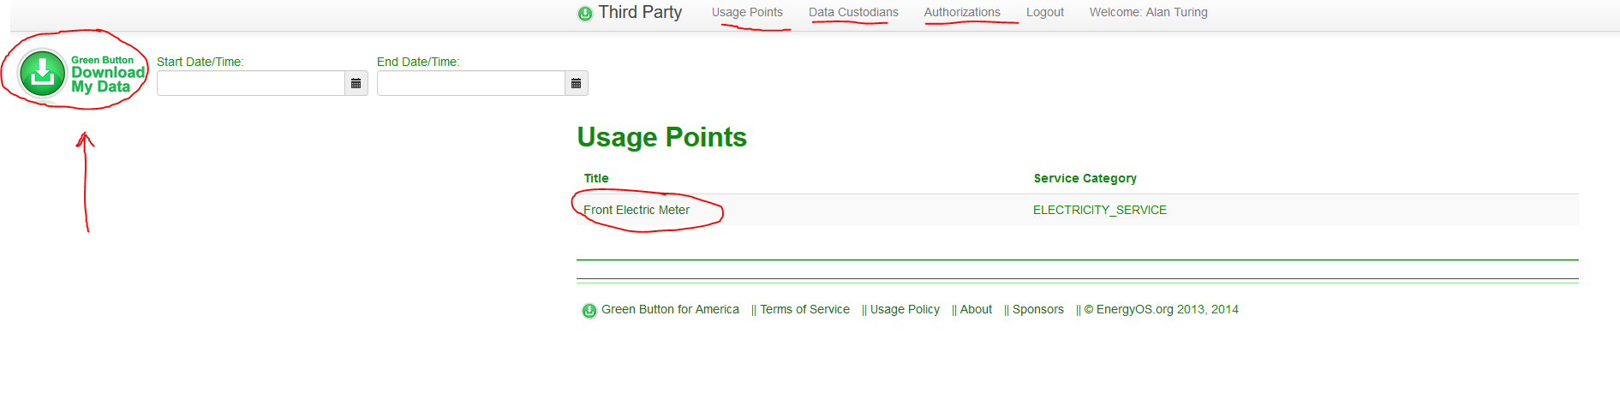
Sandbox Usage Points
Clickable “Download My Data (DAD)” and “Front Electric Meter”

Slide 5
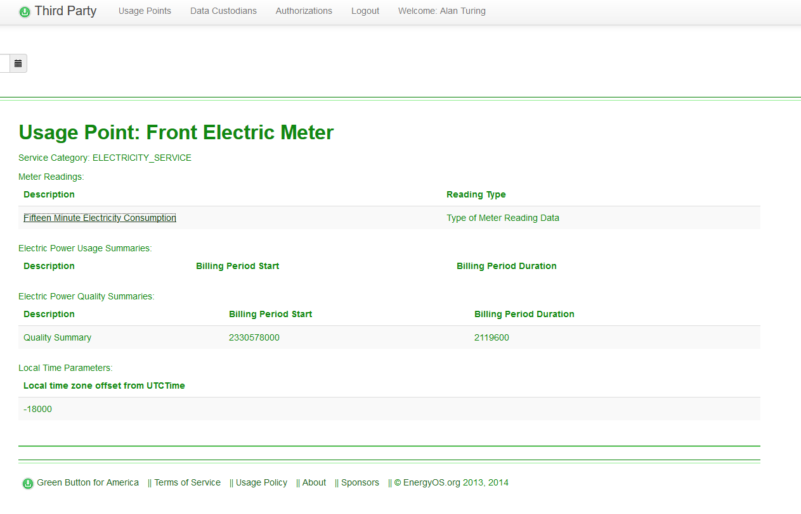
Sandbox Usage Points: Front Electric Meter

Slide 6
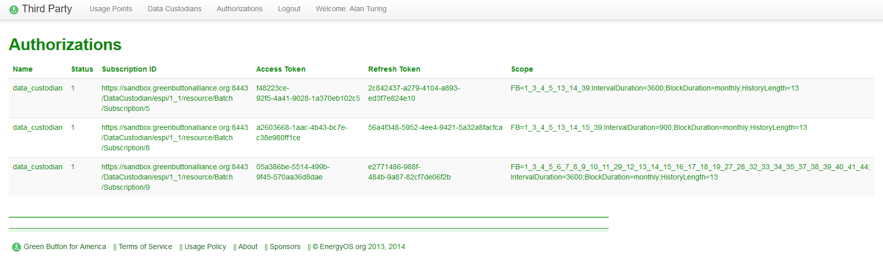
Sandbox Authorizations

Slide 7
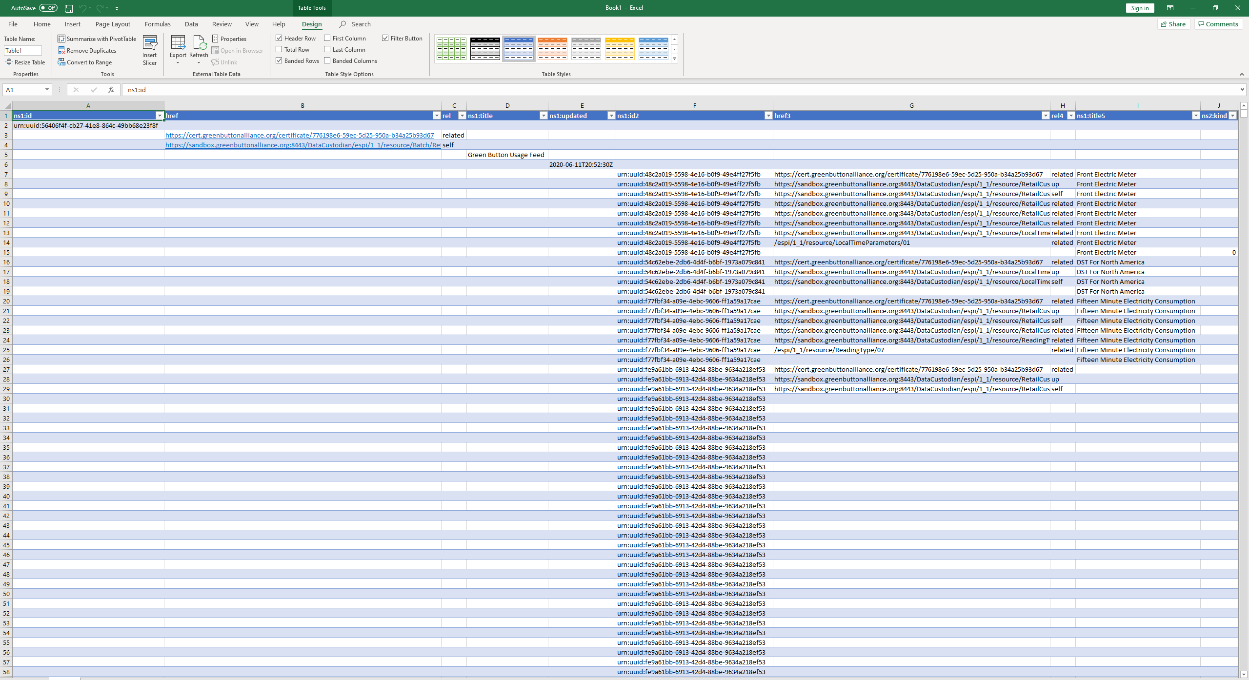
Sandbox: Download My Data XML Example

Slide 8
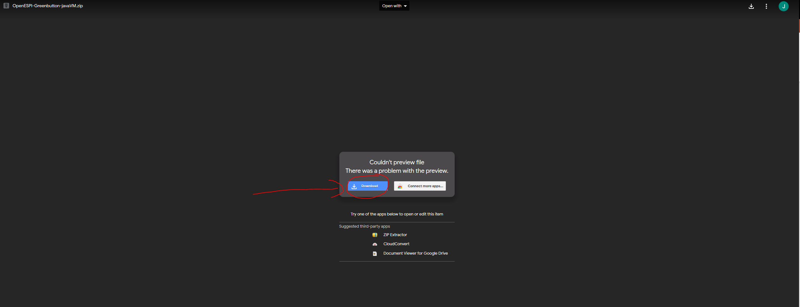
Downloading the VM
Google Drive (Shareable Link approx. 5.5 GB)
https://drive.google.com/file/d/1gkdnGIBERlPGTjo8ssm4-Ps7NhjWP1pd/view?usp=sharing

Slide 9
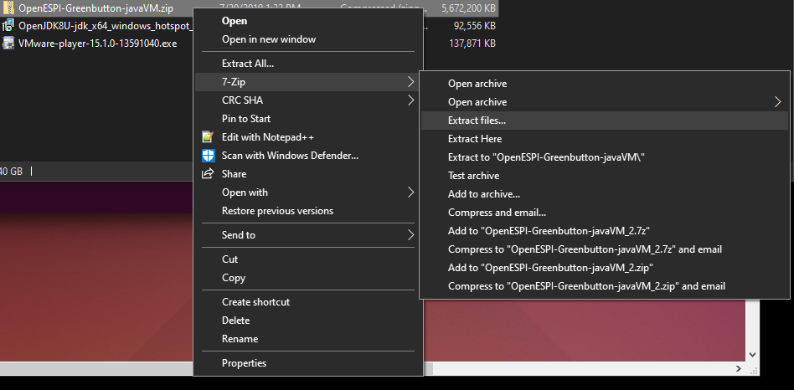
Extract the File
Locate OpenESPI-Greenbutton-javaVM.zip
Right-click and extract using Windows Explorer or 7zip

Slide 10
Download a VM Application
VMware (preferred)
https://www.vmware.com/products/workstation-player.html
VirtualBox (alternative)
https://www.virtualbox.org/
Other

Slide 11
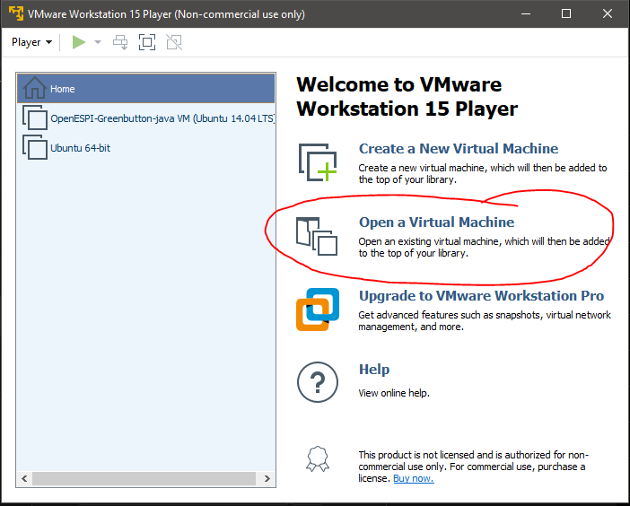
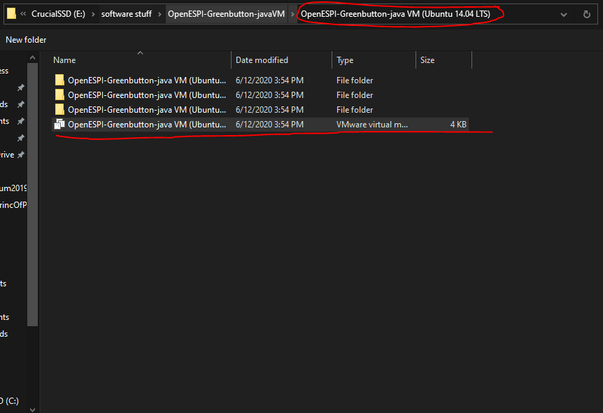
Setting up the OpenESPI VM
Launch VMware Workstation
Open a Virtual Machine
Locate and Direct to \OpenESPI-Greenbutton-javaVM\OpenESPI-Greenbutton-java VM (Ubuntu 14.04 LTS)
Open the VM

Slide 12
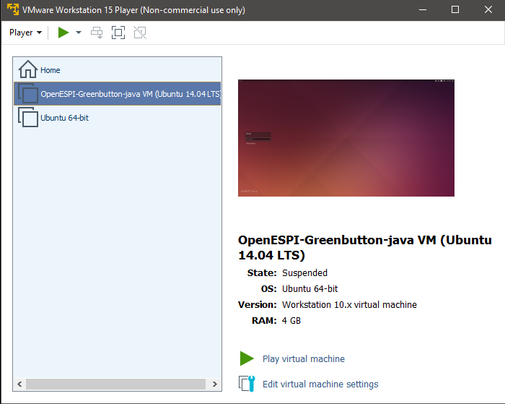
Setting up the OpenESPI VM
The VM is create and is ready to launch\
Double click the OpenESPI VM or hit Play virtual machine

Slide 13
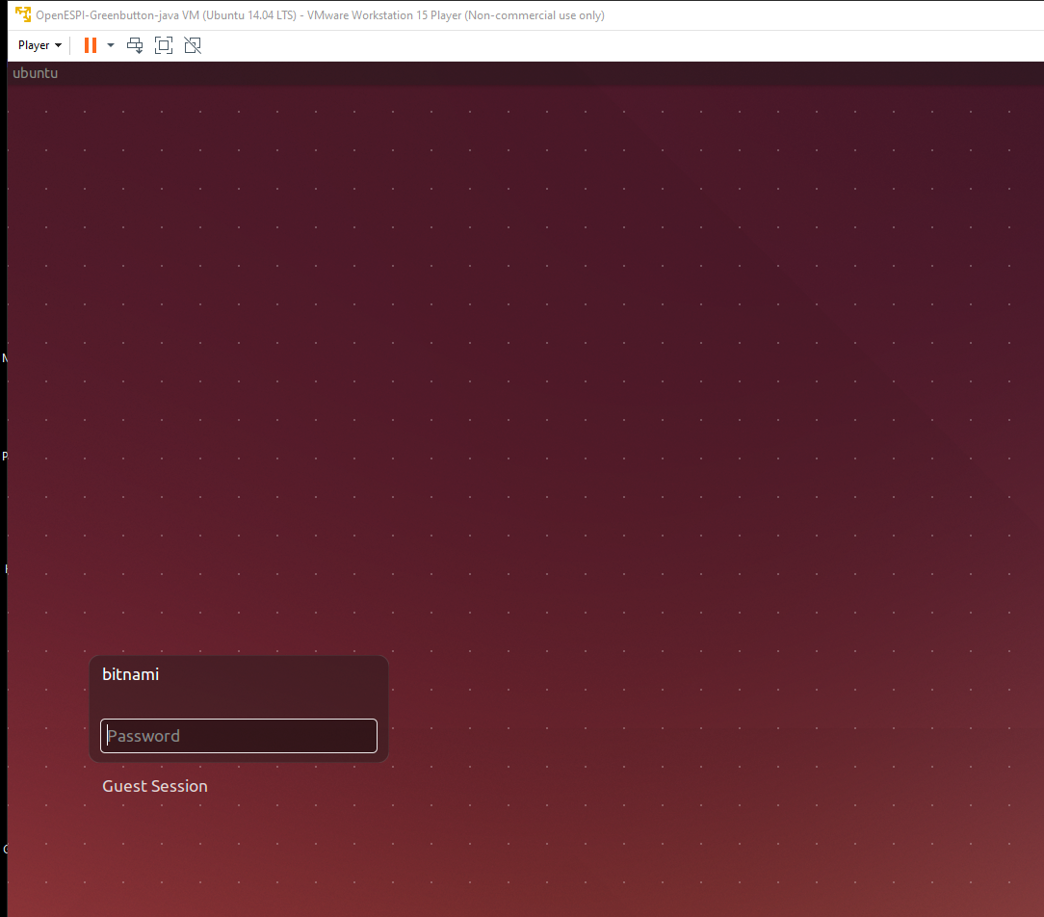
Setting up the OpenESPI VM
You should see the login page
The login info is –
Username: bitnami (lowercase)
Password: password (lowercase)

Slide 14
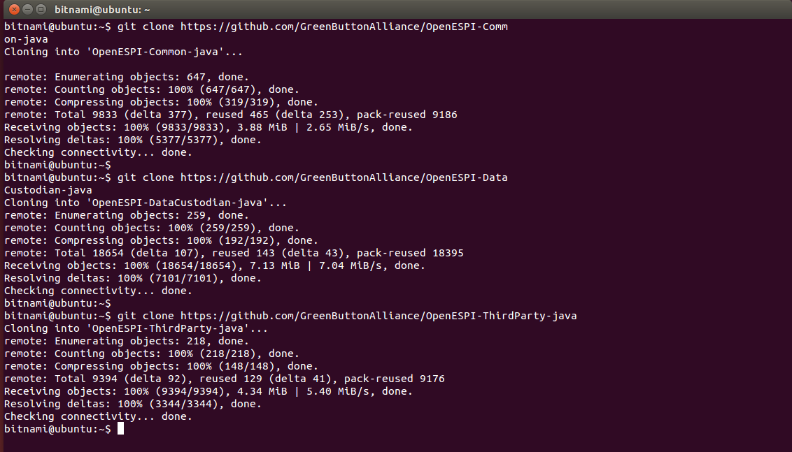
Setting up the OpenESPI VM
Open the terminal and git clone the repositories
git clone https://github.com/GreenButtonAlliance/OpenESPI-Common-java
git clone https://github.com/GreenButtonAlliance/OpenESPI-DataCustodian-java
git clone https://github.com/GreenButtonAlliance/OpenESPI-ThirdParty-java

Slide 15
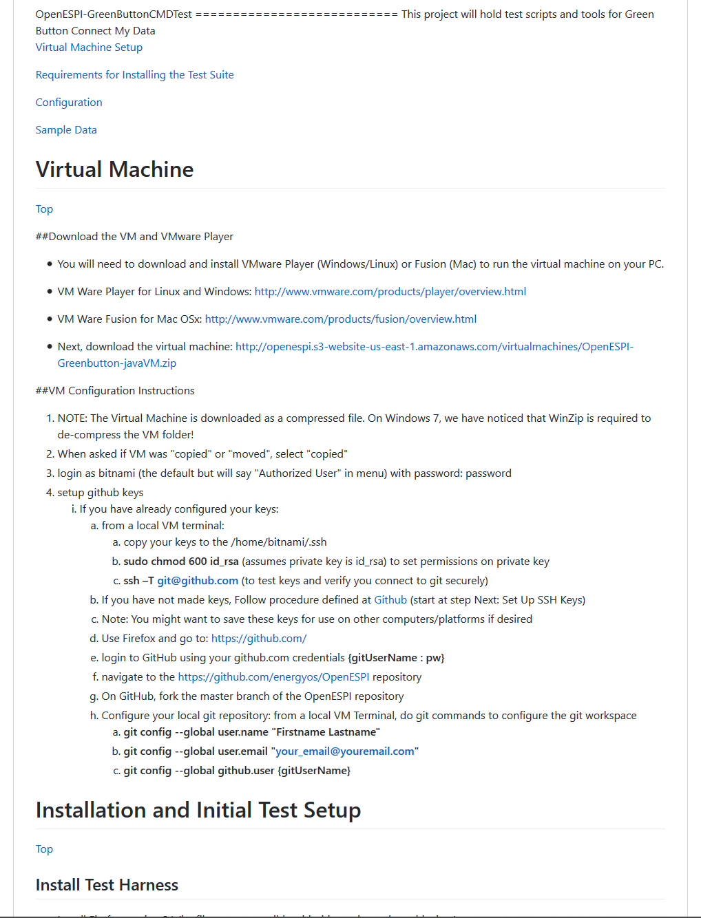
Setting up the OpenESPI VM
https://github.com/MartyBurns/OpenESPI-GreenButtonCMDTest
Source of VM (OpenESPI-GreenButtonCMDTest)
Instructions on how to install and run test setup

Slide 16
Compiling Common-java
Instructions on setup found on respective GitHub
https://github.com/GreenButtonAlliance/OpenESPI-Common-java
Clone Common-java
Change directory to Common-java (cd OpenESPI-Common)
mvn –Dmaven.test-skip=true clean install

Slide 17
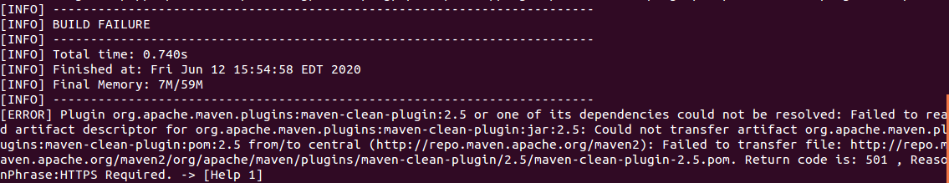
Fixing Errors
Updating Maven, JDK

